Slide 1
NU’topia
MICHAEL ANTOINE
MATT FLEMING
ETUATE VAREA

Slide 2
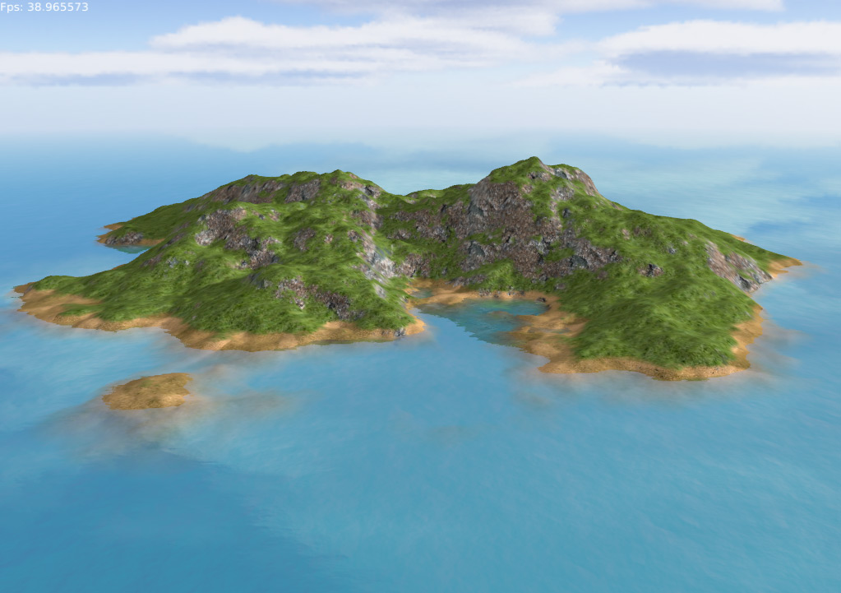
THE ISLAND
-Roughly 200 miles wide
-Originally a peninsula
-Founder dug a 15-mile wide
channel
-54 Cities located on NU’Topia
-Capitol City of Amaurot
-Western Hemisphere
-Founded by King Utopos
-Visited by Vespucci’s men in 1507

Slide 3
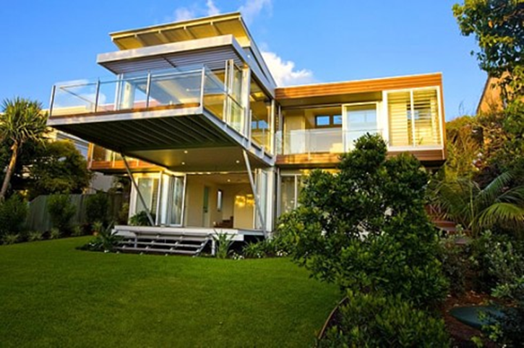
Housing
-Beautiful well constructed homes
-Large community households

Slide 4
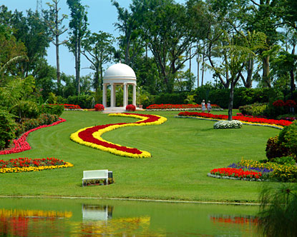
Gardens
-Every home has a garden
-World renown for beauty
-Beautiful place for retreat and
relaxation

Slide 5



Family life
-Full-time service
-Freedom of religion
-Education opportunities
-No class distinction
-Low divorce rates

Slide 6
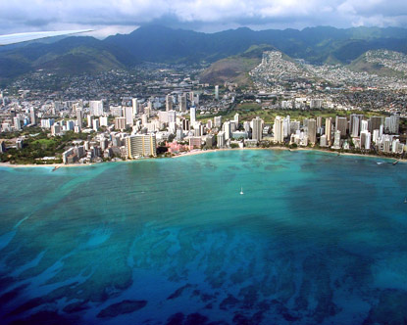
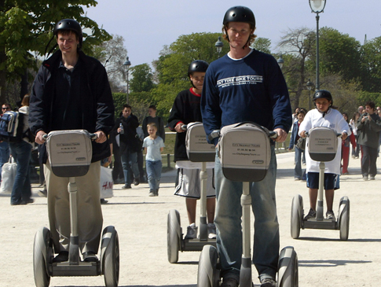

Recreation/Leisure
-Island life style
-Outdoor activities/games
-Travel opportunities

Slide 7
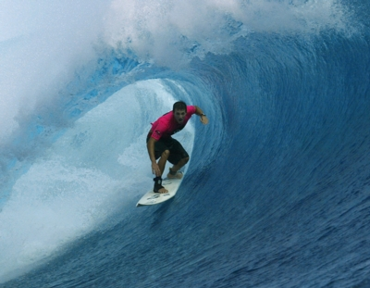
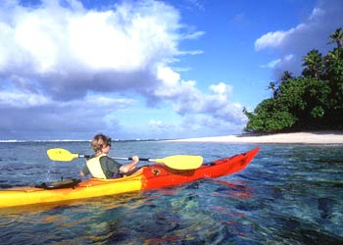

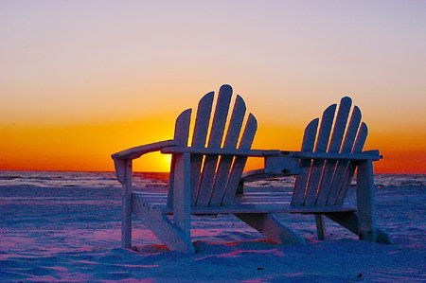
ISLAND LIFE
Many activities to do on the island after work
Or relax in the tranquil environment

Slide 8
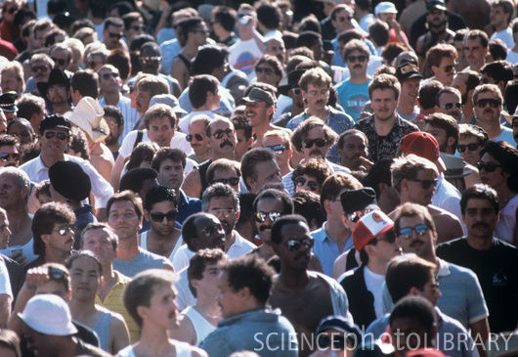


Travel Opportunities
If Nu’topia gets OVERPOPULATED
Or
You want to STUDY ABROAD
All expenses PAID relocation to NEW places
Don’t worry about foreign policy, we can CHANGE it.

Slide 9

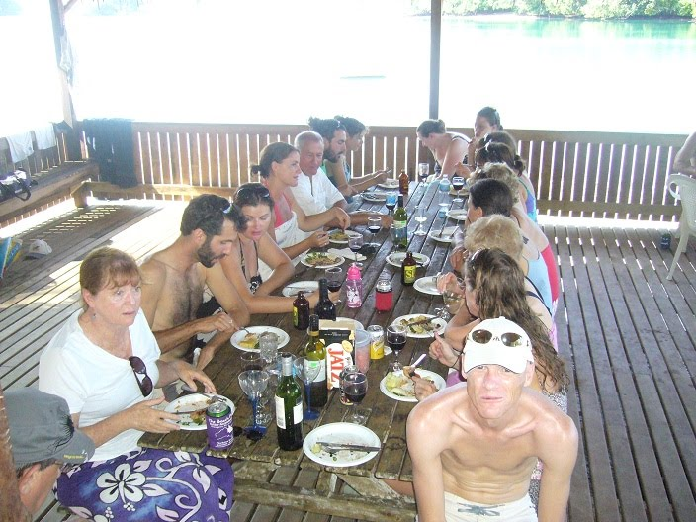
Resources
-Unlimited food supply
-Free to all
-Fully prepared meals
-Buffet style dining

Slide 10

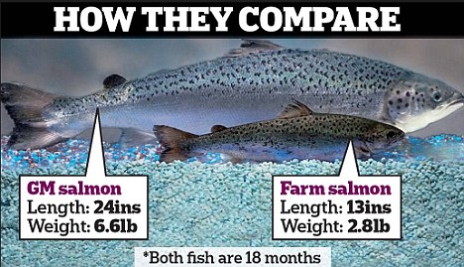
Unlimited Food Supply
G
M
O
Notes:
10

Slide 11
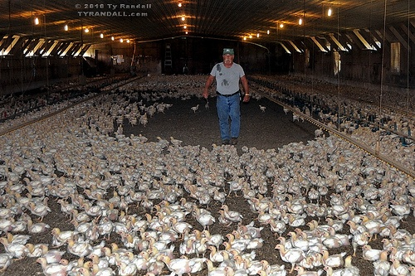
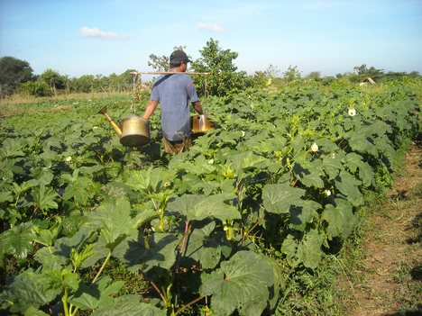
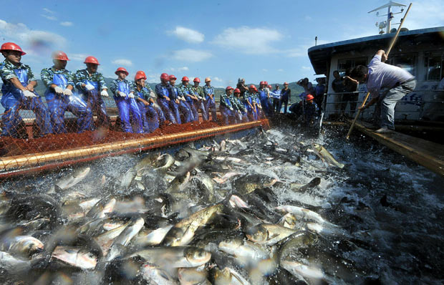
Free Food to all
Farmers work together in:
Raising animals
Growing Fruits and Vegetables
Raising fish and assorted seafood
Notes:
11

Slide 12



Prepared Meals
Chefs preparing meals during 6 hour work period

Slide 13


CAREER CHOICES
-Pick from a diverse options of careers
-Hands on training
-Transfer Options

Slide 14
Career Life
-Shortest work day
-Extended work hours
-Gives you more leisure time

Slide 15

JOB SECURITY
-Everyone in NU’Topia is employed
-You will fill a valuable role
in NU’Topia

Slide 16

BENEFITS
-Free Healthcare
-Euthanasia
-Paid Expenses to the Country
-High Standard of living
-Paid Travel Expenses to the
country side

Slide 17
REPRESENTATION
-A Syphograntus is elected per every 30 Households
-One Traniborus per every 10 Syphograntus
-200 Syphograntus elect a life long Prince

Slide 18
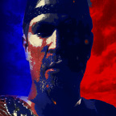
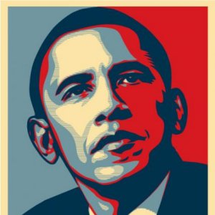
POLITICAL PARTIES
-No political parties
-No pointless political bickering
-Life time of steadfast leadership
?

Slide 19

Why Not a Prince?

Slide 20
CHOOSE NU’TOPIA!!!

